Slide 1

Do Google Search Trends affect the price of Cryptocurrencies?
Kenney Kwan

Slide 2
Why?
Since Cryptocurrencies first came onto the market in 2009, they have garnered an immense amount of praise and criticism. The controversial nature of crypto causes the topic to jump into mainstream media every few years. The high volatility of cryptocurrencies makes it hard to predict how each stock will move. But what if we were able to look at google search trends and use that to predict how well cryptocurrencies are doing?
Recent news of Elon Musk has made headlines by announcing that Bitcoin, Ethereum, and Dogecoin was going to be an acceptable mode of payment for their future project of landing on Mars. Having all this attention and people talking about these coins shot the prices up overnight to record highs. What insights can we perceive from looking at google trends data and stock data of cryptocurrencies?

Slide 3
Datasets
CCi30 Index – The CCi30 is a rules-based index designed to objectively measure the overall growth, daily and long-term movement of the blockchain sector. I am looking to mimic this index
Top cryptocurrencies from Yahoo Finance – To mimic the CCi30 index we pulled data from the Yahoo Finance API. To measure the price of stock, we pulled daily ‘Closing’ price of each stock.
Stocks included in our data: ['BTC-USD', 'ETH-USD', 'DOGE-USD', 'XRP-USD’]
Google Search Trends Dataset – Looked at popularity of search terms from top cryptocurrencies- “Bitcoin”, “Ethereum”, ‘XRP”, “Dogecoin”.

Slide 4
Data Cleaning
Problem 1 – Aggregating data of cryptocurrencies is not consistent. Pulling daily stock data from Yahoo Finance API from 1/1/2015 to 8/1/2021 which gave us 2401 rows and 30 columns. However, there were many missing values present. Many cryptocurrencies did not exist in 2015. Some columns of stock closing prices had over 1500 or more missing values. Removing the rows and columns with many missing values left us with 1025 rows and 19 columns. For any other missing values found in the middle of the dataset, we used forward fill to take the last closing price and fill missing values with those values.
Problem 2 - Our Google Trends Dataset measured the popularity of different google search terms measured as weekly data. To match my stock price data and trends data, I resampled Yahoo Stock Data from daily measurements to weekly measurements, further reducing the number of samples.

Slide 5
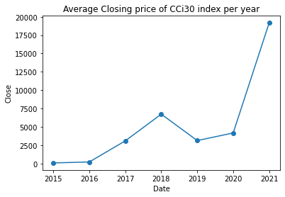
EDA
The CCi30 index takes in data from the top 30 crypto currencies and returns a value that represents the overall health of the cryptocurrency sector. It is formatted like a typical historical stock data table with “Date”, “Open”, “Close”, ”High”, ”Low”, and “Volume” as columns.
Our goal is to mimic this index from our own dataset from Yahoo Finance

Slide 6
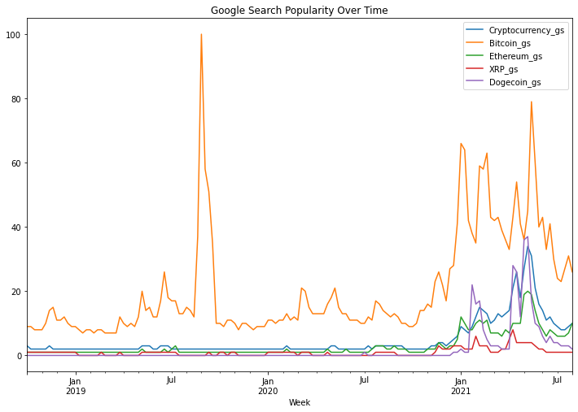
EDA
Representation of google search trends based on search words
Bitcoin dominates google search results. It is the largest and most popular cryptocurrency on the market.

Slide 7
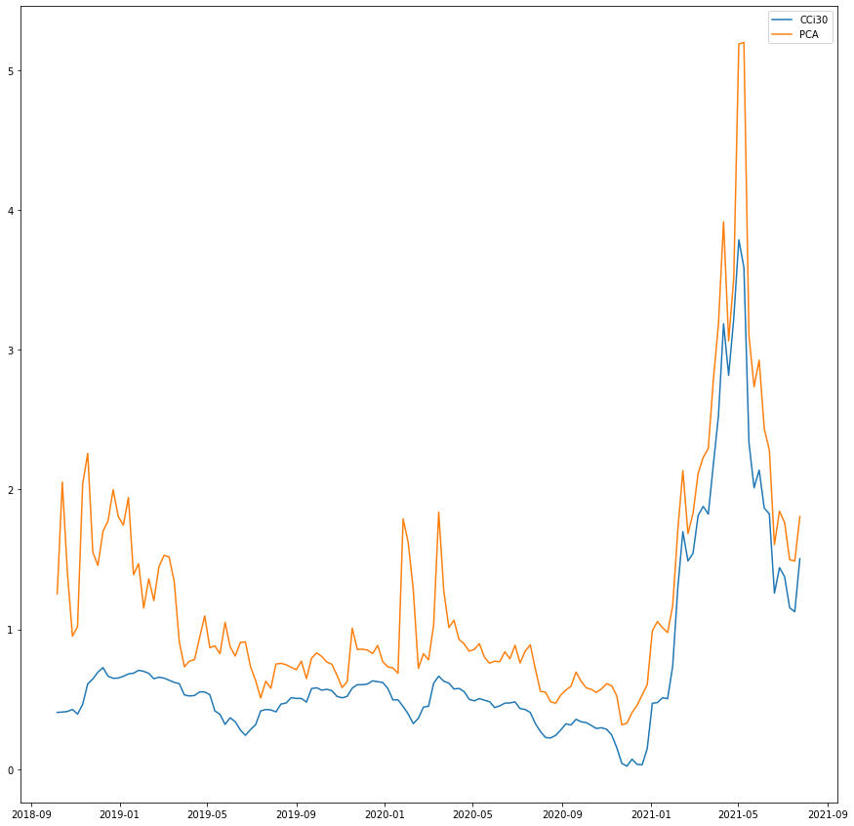
EDA
Representation of the CCi30 index on Closing price and my estimation of the CCi30 index
The two graphs are extremely similar with a huge peak in May 2021
My PCA estimation is a good dataset to use for comparison with google trends

Slide 8
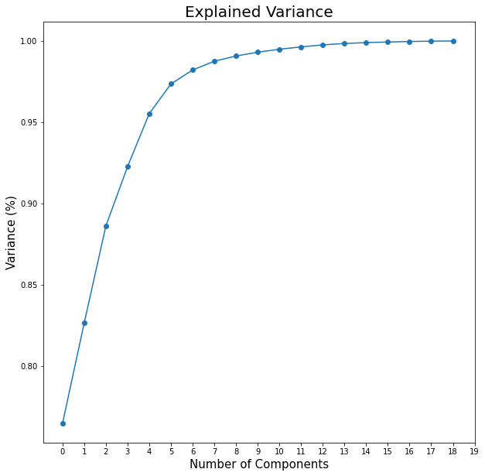
PCA Analysis
PCA analysis on Yahoo Stock Prices to reduced the number of features from 30 down to 4 and decorrelated the features.
PCA analysis showed an optimal number of 4 components that explains 92% variance of the distribution.

Slide 9
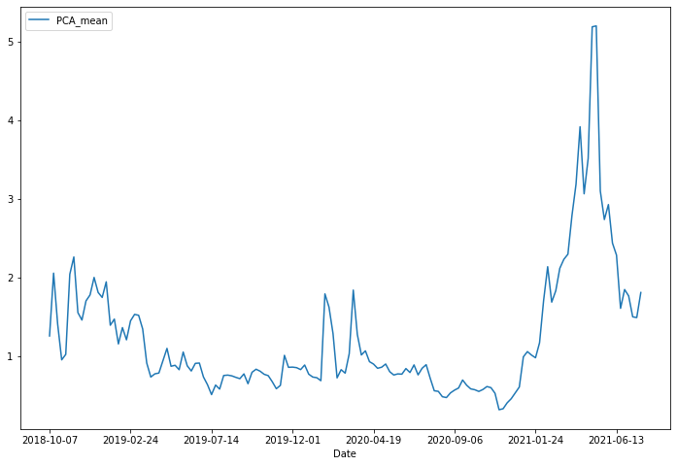
PCA Analysis
PCA as a visualization tool. I took the row wise mean of the 4 PCA components and plotted it
The row wise mean shows the mean of the eigenvectors of the 4 principal components for each week of our sample. Eigenvectors explain which direction (either rise or fall) our stock prices will go in the mimicked “CCi30 index”.

Slide 10
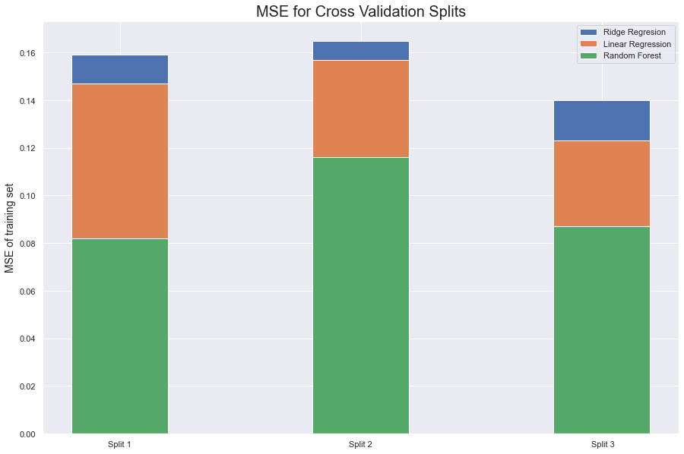
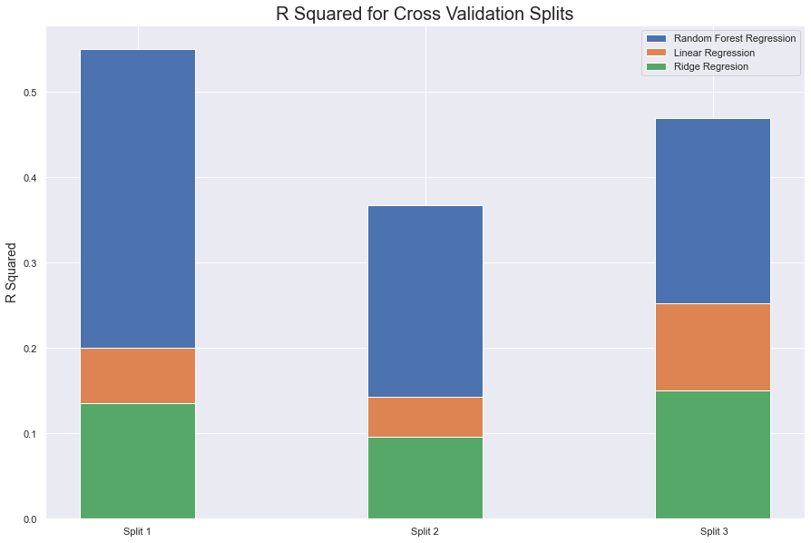
Model

Slide 11
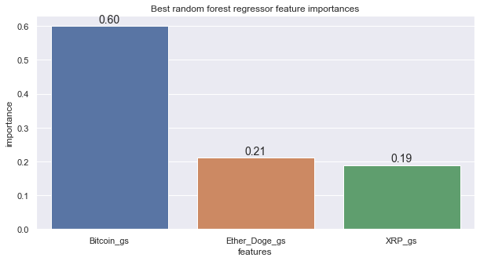
Model
Random Forest Regression was the best performing model in R squared, and on MSE
R Squared had an average score of 0.46 across cross validation splits with a mean MSE of the training data of 0.095 and a mean of the test MSE of 1.19.
Bitcoin google searches has the biggest impact out of all the independent variables.

Slide 12
Recommendations
The model shows that google search trends does have some impact on the price of cryptocurrencies. Keep people’s interests high on this topic may prove to be healthy for the cryptocurrency market
Bitcoin’s affect on the market is significant. Bitcoin dominates in both stock price and google search trends. Expect the price of the coin to increase when more people are talking about it. As Bitcoin starts to reach its maximum capacity, expect more conversation to be generated over the remaining limited supply.
Bitcoins feature importance is a problem in this model. Its weight is too high to see the effects of the other features on the data. The overall health of cryptocurrencies is highly dependent on how bitcoin is doing. This skews the data to lean towards bitcoin for our predictions

Slide 13
Further Research
Further research can be done on expanding the possible variables that measure people’s interest in crypto currencies. Accessing tweets through the twitter api and looking at hashtags could provide some more insight on the type of discussion that users are generating. This can be further investigated to classify if discussions are positive or negative by using NLP algorithms.
We can also categorize people’s interest via age and gender. It would be interesting to which groups of people are talking about cryptocurrencies.
There has been an increasing amount of “scam coins” entering the market recently. These are coins that are heavily promoted via social media, luring people to invest heavily in the coin, inflating the price, only to have the owners sell all their stock and leave with the money. What if the model can measure the amount of interest a coin is generating and determine if a crypto currency is legitimate or a scam?

